Slide 1
Lab 6:
Camera Calibration
4/13
Sean

Slide 2
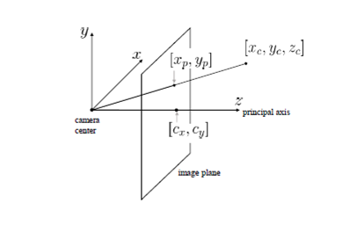

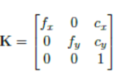
In Lab 5...
cx, cy : image center (pixel)
fx, fy : focal length
xp, yp: index of the depth image
xc, yc, zc : camera coordinate
x, y, z: real world coordinate
Pin hole projection
Intrinsic matrix
With intrinsic matrix and depth, one can get the position of pixel w.r.t. camera coordinate

Slide 3
But how to get the coefficients?

Slide 4


Camera Calibration
Detect the pixel of key points in the pattern of given image. For chessboard pattern, they are corners (red dots in left figure)
Reproject the corners to the homography plane and build the correspondences (3D < - > 2D)
Collect data in different views, then get the result!
OpenCV functions: here

Slide 5
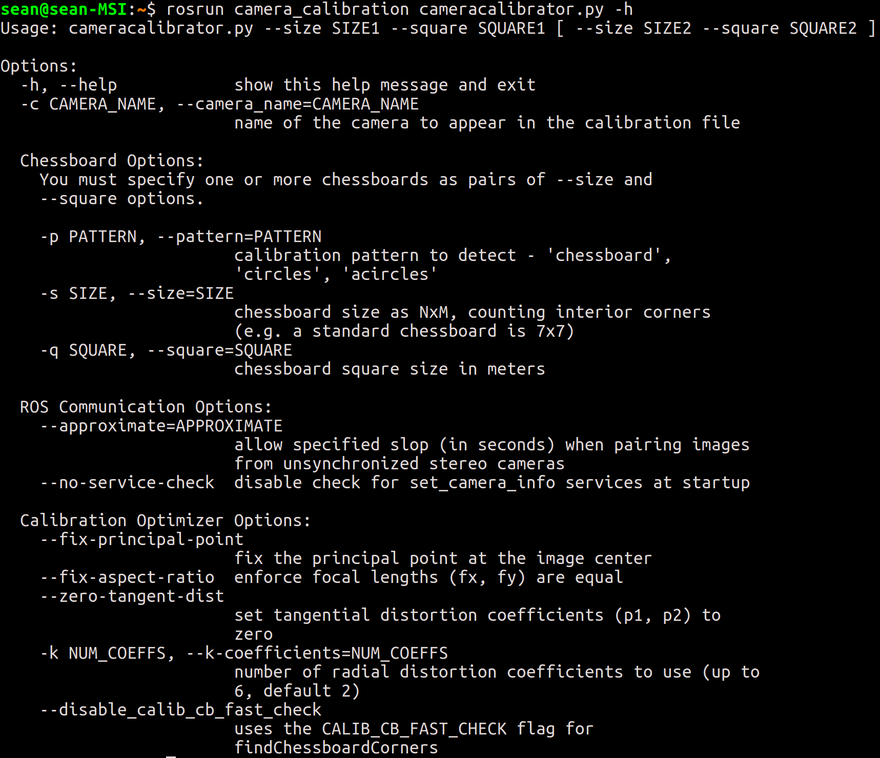
Topic 1: Calibrate Your Laptop Camera

Slide 6
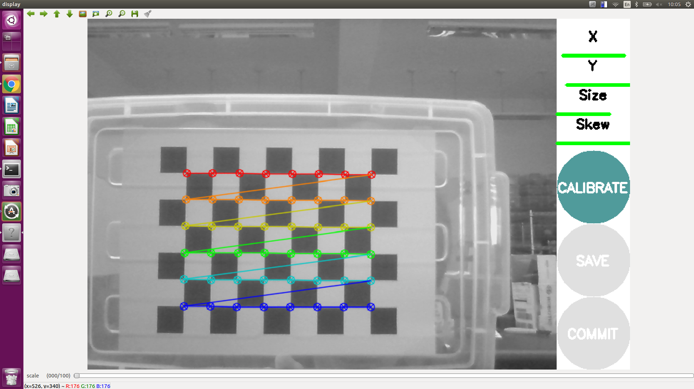
Topic 1: Calibrate Your Laptop Camera
Turn on your camera, open the calibration GUI and put the chessboard in the FOV
Make the chessboard in different pose until the `CALIBRATE` button is clickable

Slide 7
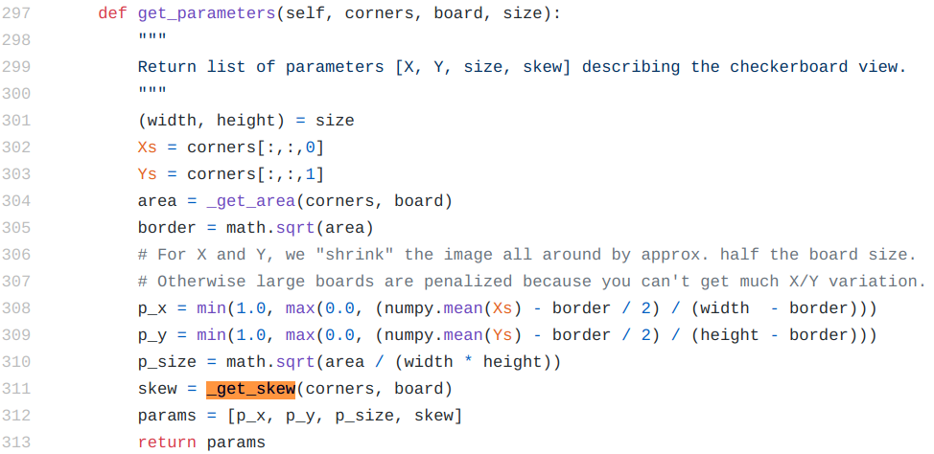
Topic 1: Calibrate Your Laptop Camera
X: left / right
Y: up / down
Size: near / far
Skew: tilt angle
The more data you collect, the more computation time it takes
After click `CALIBRATE`, the UI will turn into grey but it is still running! Wait a moment
code

Slide 8
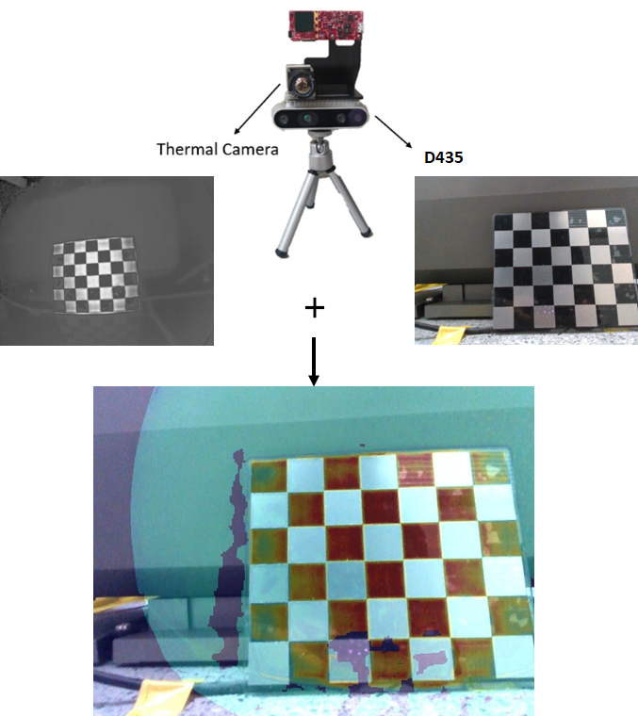
Topic 2: Align Thermal Image into Color Image

Slide 9
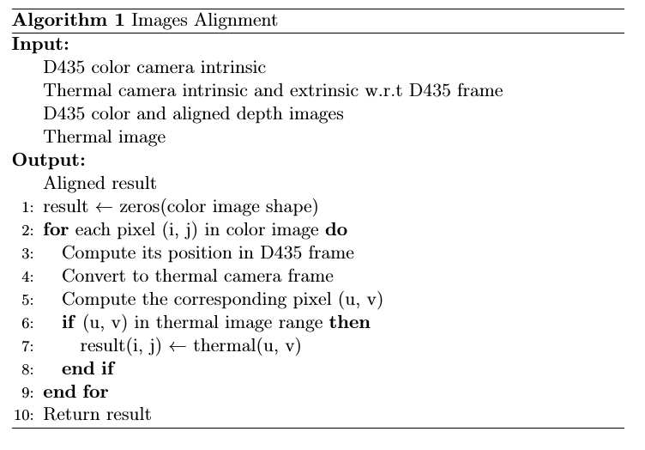
Topic 2: Align Thermal Image and Color Image
To do so, you need not only intrinsic but also the extrinsic
Intrinsic of thermal camera
Extrinsic, or transformation matrix from D435 to thermal camera
Same concept as Topic 1, while this time we use 3D coordinate in D435 frame
Alignment pseudo code

Slide 10
Topic 3: Hand-Eye Calibration
For human, we can use our eyes to sense the object and manipulate with it by our hands
How about robot?
Robot system usually uses camera (i.e., eye) to sense the environment and robot arm (i.e., hand) to interact with it
But they are two independent subsystems, we have to build the connection
The process is called hand-eye calibration, which is a important process for robotic manipulation
In this topic, we mainly focus on fixed eye configuration, i.e., the camera is mounted in a fixed position out of the robot arm

Slide 11
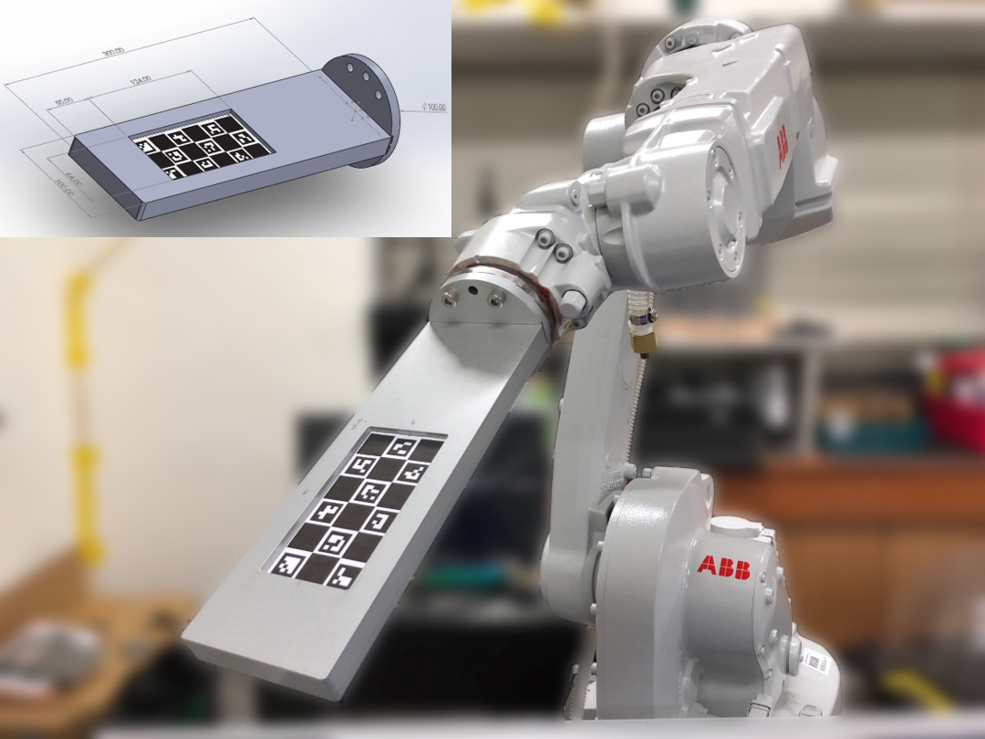
Topic 3: Hand-Eye Calibration
Point sets registration [2]
Pattern position in camera frame
(Detection)
Self-designed calibration board
Pattern position in robot arm frame
(Inference)
ChAruco

Slide 12
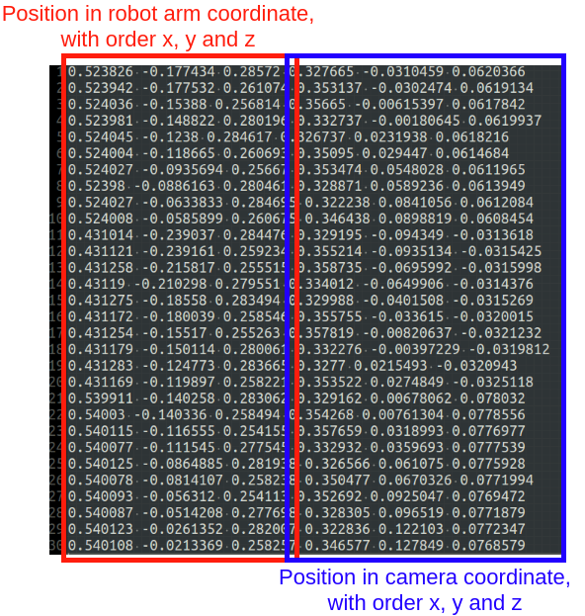
Assignment
You are assigned to create a package, write a C++ node to implement the algorithm with the data we collected

